Slide 1
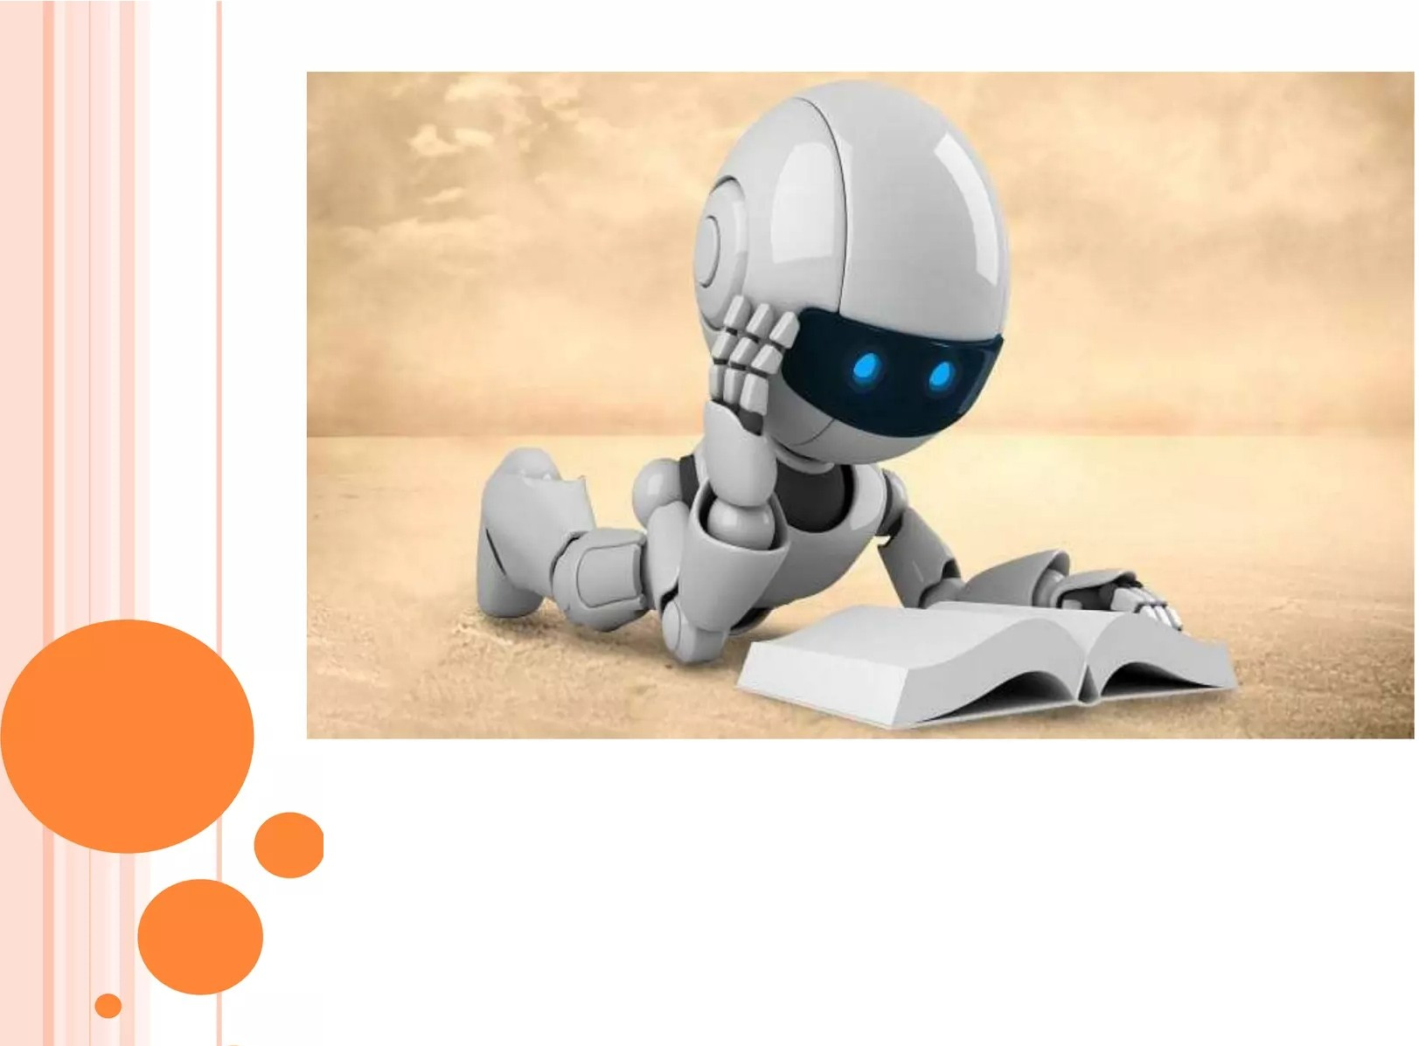
PRESENTA TION ON A
¹¹CHA TBOT¹¹
BY:
RAKIBUR RAHMAN RAFAN
Reg: 18502003671
•

Slide 2
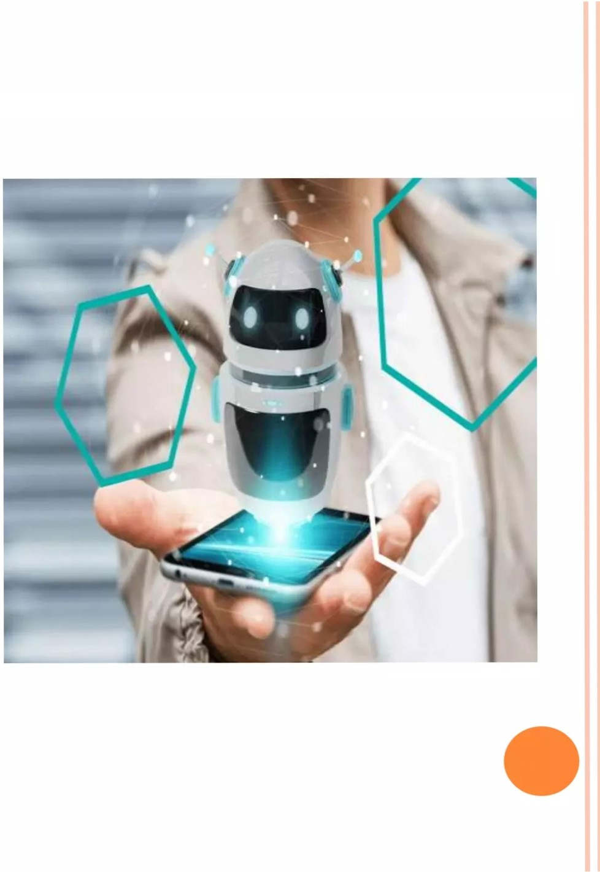

Introduction
History of Chatbot
o Educational requirement
System requirement
How does it work?
o Types of Chatbot
o We need a bot that can
0 Principles of Chatbot
0 Data Flow Diagram
0 ER Diagram
0 Architecture
0 Advantages & Disadvantages
0 Conclusion
0 References

Slide 3


What is a Chatbot?
INTRODUCTION
A chatbot is an intelligent piece of software that is capable of communicating and performing actions similar to a human.
Uses of Chatbot:
Chatbots are used a lot in customer interaction, marketing on social network sites and instantly messaging the client.

Slide 4

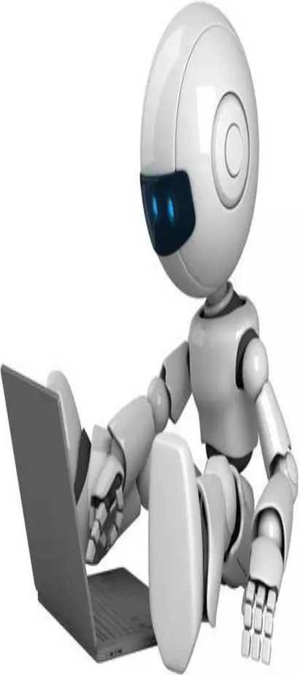
H ISTOR Y OF CHA TBOT
The first Chatbot ever was developed by MIT professor Joseph Weizenbaum in the 1960s. It was called ELIZA. You'll read more about ELIZA and other popular Chatbots that were developed in the second half of the 20th century later on.
In the year 2009, a company called WeChat in China created a more advanced Chatbot. Since its launch, WeChat has conquered the hearts of many users who demonstrate an unwavering loyalty to it. It is a highly thriving social media platform.

Slide 5


The Project is developed using Python as a language and we use JetBrains Pycharm as IDE. Created and maintained all databases with json.
The project requires you to have good knowledge of Python, Keras, and Natural language processing (NLTK). And some Helping Modules are Tensorflow, Keras, pickle, and nltk.
EDU CA T I O N A L REQUIREMENTS

Slide 6
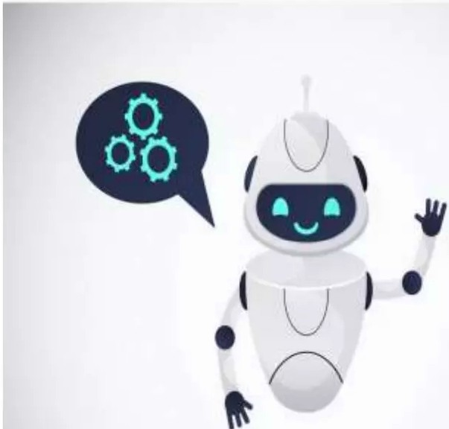



SYSTEM REQUIRM ENTS
1. Hardware requirements
Processor-Intel Pentium or higher
RAM-minimum->4GB
maximum->6GB
2. Software requirements
Front End-OS-Windows
7,8,10
Back End- Python must be installed
3.Python IDE(jetBrains Pychram)

Slide 7


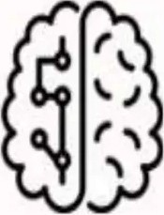



HOW DOES IT WORK
Ref1 utst artafy;z.ed by
artiH'cial intelfigenct
Ustr info taken frtto
account (history,
Real tiw.t respo»tlt CoYlvtrso.tional straty lrtttrnctio1'\5
person.afi ation
preferences ...)

Slide 8


TYPES OF CHATBOT
1.Flow-oriented Chatbot
2.Artificially Intelligent Chatbot:
3.Hybrid Chatbot:
4.Human supported bots

Slide 9
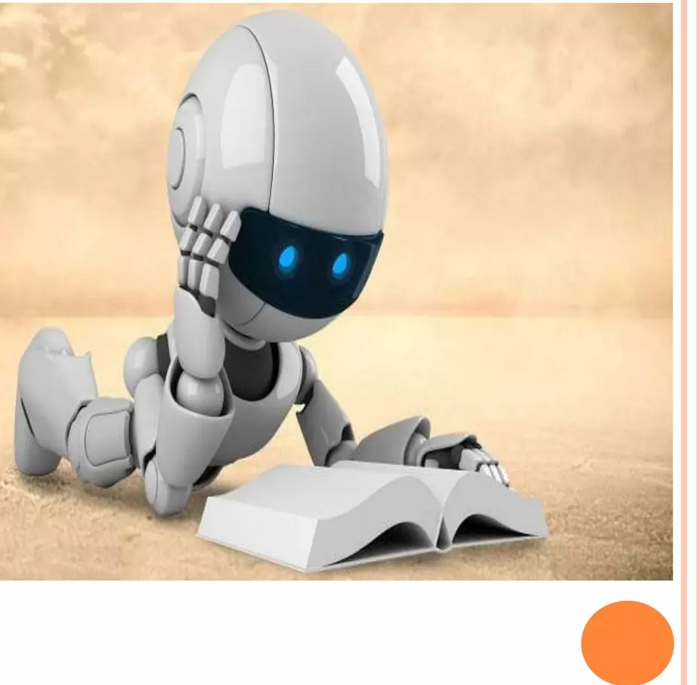
WE NEED A BOT THAT CAN
o Provide seamless self-service support within its help desk
o Make a city for intelligent
o Change the way we do
HR

Slide 10

PRINCIPAL ES OF CHATBOT
o Don’t pretend to be a human-
Playing bait-and-switch with a user can make them feel that they have been duped, or that they don’t understand how a system works; both are bad user experiences. Don’t pull the rug out from under your users. This means not using "is-typing" indicators or artificial delays to make it seem more human. On the contrary, bot messages should be styled differently and be clearly labeled in a way that communicates they are not human. This doesn’t preclude us from giving the bot personality.
o Keep it incredibly simple-
Bot conversations should be bounded to very particular subjects and follow linear conversation routes; we avoid complicated branching paths. We’re not
trying to create a general, self-aware A.I. here. Ires okay to expose and explain limitations. BASAAP. Individual bot designers shouldn’t have to account for tricky failure cases. Users will tire of complicated passages of dialogue.

Slide 11

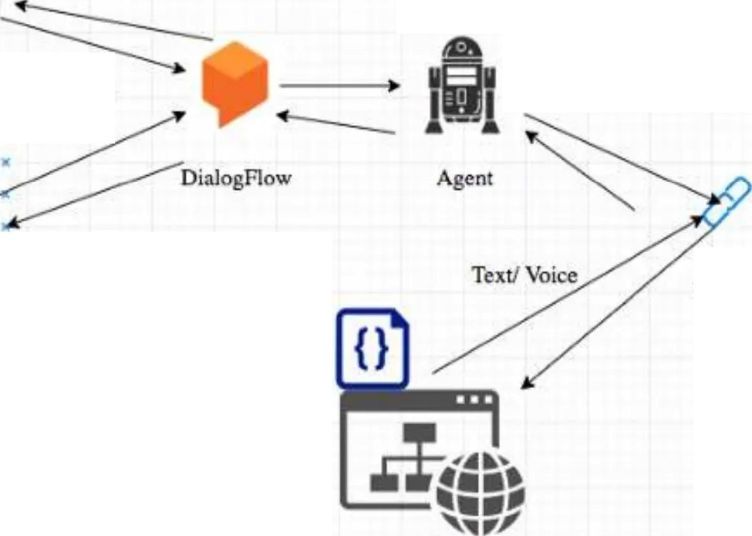
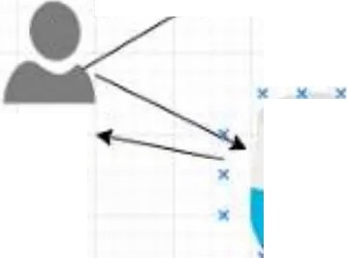
Data FLOW DIAGRAM (DFD)
Text
Input
User
Voice
lntent
Fulfillment

Slide 12
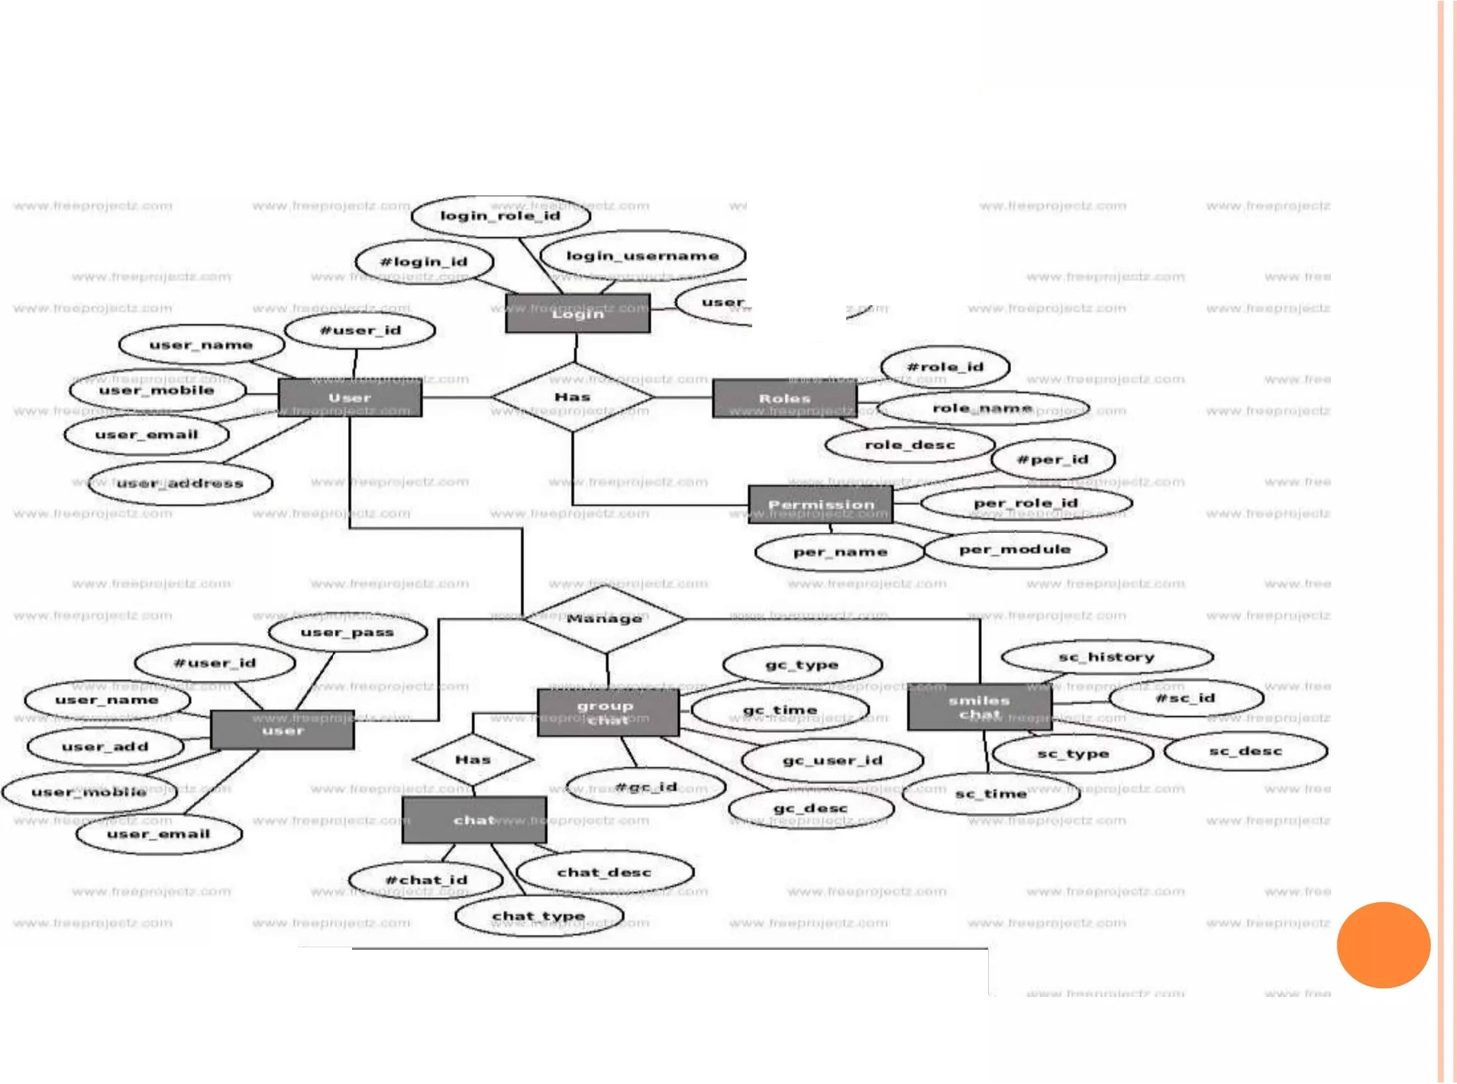
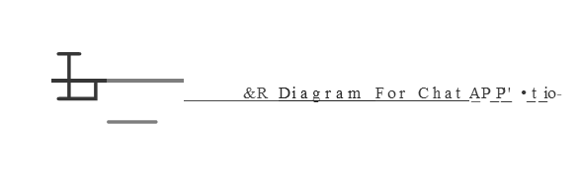
ER diagram
u•or pAssword
-
---

Slide 13

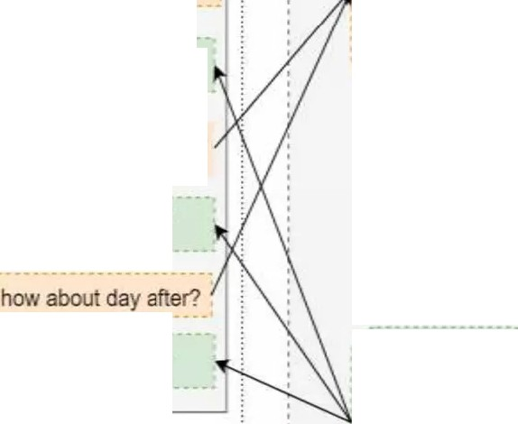
CHATBOT ARCHITEC TURE
r--------------------------------------------------------------------------- .
'
......-····-·········-············- ·······················... !
'
Chat bot architecture
NLU component
Hello --+---..---...(extract intent and
entities)
Hi<name>, how can I help_ yo_u?
ntent and entities
Database request 1
URL request
what is the weatherlookinglike tomorrow?
Tracker Slots
t
Dialogue Mgmt (model predicts next_action based on previous actions.actJon results. slots)
next action_)
its going to be mostly oudy with litt_le_ rain
APIcall
its going to be sunny
Message
Generator (use prfHiefined -•- templates with placeholders)
0 ....
-nnext action
···-......................·-····-·-·-····-··-· ······--··-·-··-·- ·- ···
''
'--- ------- -------- --------------------- -------- ------------------ -----------
=----·----·- -····---··-····-····-·-·-- -·-·····--·--·- ·····--··---·······-----·- ····-- --·····-·----·-······- ·---···-······--··--·····-·-·-·-··-·····-·-·---·····--··--..-.........-... , , ............--·-········:

Slide 14





APPLICATION OF A CHATBOT
Accessi ble any time.
Handling capacity.
Flexible attributes.
Customer satisfaction
Cost effective.
Faster onboarding.
Work automation.
Personal assistant.Accessible

Slide 15
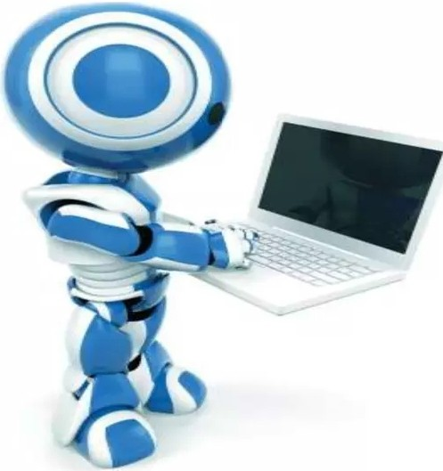

ADVANTAGES
1)User does not have to go personally to the college office for the
.
This application enables the students to be updated with college cultural activities.
This application saves time for the student as well as teaching and non-teaching staff.

Slide 16

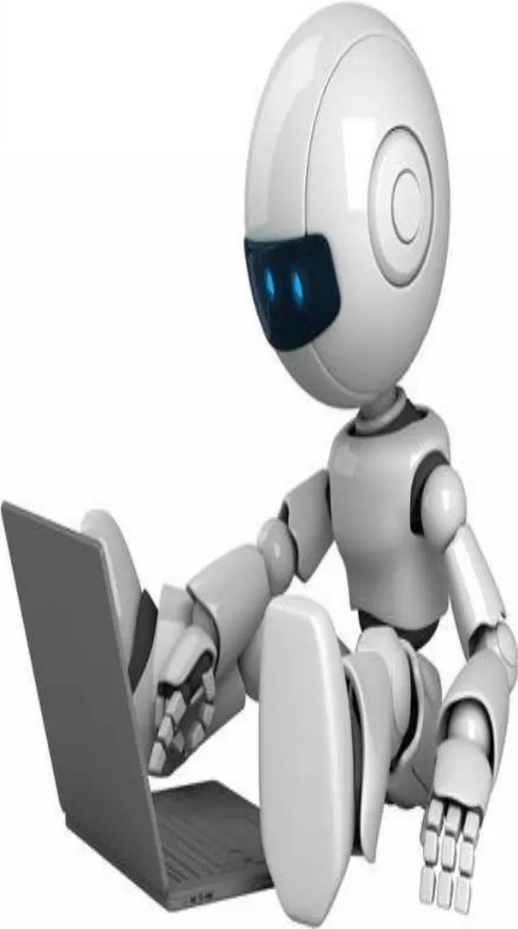
DISAD V AN TAGES
Lack emotion.
Difficult to create.
Require maintain.
It require active internet connection as error may occur.

Slide 17
SUCCESSFUL EXAMPLE OF C HATBOT:
·-• ·-•
·-•
-
-
• 1
Bots
Halloween
U>mme c1co<1irnc
eon1011r •
Dommagc 1 Je sv•sdesote
Wetcom Aooardl
Bon1our,comment a va1
Vo1c1un de mes ilm1s Robeit
'1lonj0Ut I
Dis boni r a Robert I
you
•
1 2 3 4 5 6 7 8 9 0
duolingo
3 4 5 6 7 8 9 0
€ &
@
II
€
& @
II
0
Q
Boh
mm
?
@
?
@
00
spacja return
(\
.._
spac)a
return
"
('
.._
._

Slide 18

CONCLUSION
The main objectives of the project were to develop an algorithm that will be used to identify answers related to user-submitted questions. To develop a database where all the related data will be stored and to develop a web interface. The web interface developed had two parts, one for simple users and one for the administrator.
A background research took place, which included an overview of the
conversation procedure and any relevant chatbots available A.
database ,
was developed, which stores information about questions, Answer
keywords, logs and feedback messages. A usable system was designed, developed and deployed to the web server on two occasions. An evaluation took place from data collected by potential students of the University. Also after received feedback from the first deployment, extra requirements were introduced and implemented

Slide 19


REFERENCE
Emanuela Haller and Traian Rebedea, "Designing a Chat­ bot that Simulates a Historical Figure", IEEE Conference Publications, July 2013.
Maja Pantie, Reinier Zwitserloot, and Robbert Jan Grootjans, "Teaching Introductory Artificial Intelligence Using Asimple Agent Framework", IEEE Transactions On Education, Vol. 48, No. 3, August 2005.

Slide 20
